Slide 1
PROJECT TITLE Railway Seat Reservation System
GITHUB LINK - LINK

Slide 2
Railway Seat Reservation System
Group member details:
21CS8120 - Siddharth Pandey
21CS8122 - Pankaj Sah
21CS8123 - Sudipta Das
21CS8124 - K.O.S.Balaji
21CS8125 - Ayan Baral
21CS8126 - A.Satish
21CS8127 - Soham De
21CS8128 - Soumi Sharma
21CS8129 - Ananda Sau

Slide 3
Problem Statement:-
Railway Seat Reservation System
We are designing and implementing a reservation platform for railway seats/berths. This project aims to provide a comprehensive solution for users to efficiently book their preferred accommodations and travel options.
The system has features such as:-
User registration and login from various devices with user-friendly interface to book or cancel tickets.
Display the various trains and seat matrix in proper format

Slide 4
SCHEMATIC OVERVIEW OF RESERVATION SYSTEM
User
Display train schedule
Book/Cancel Ticket
Register User/
Authenticate User
Seats empty
Update Seat Matrix
User

Slide 5
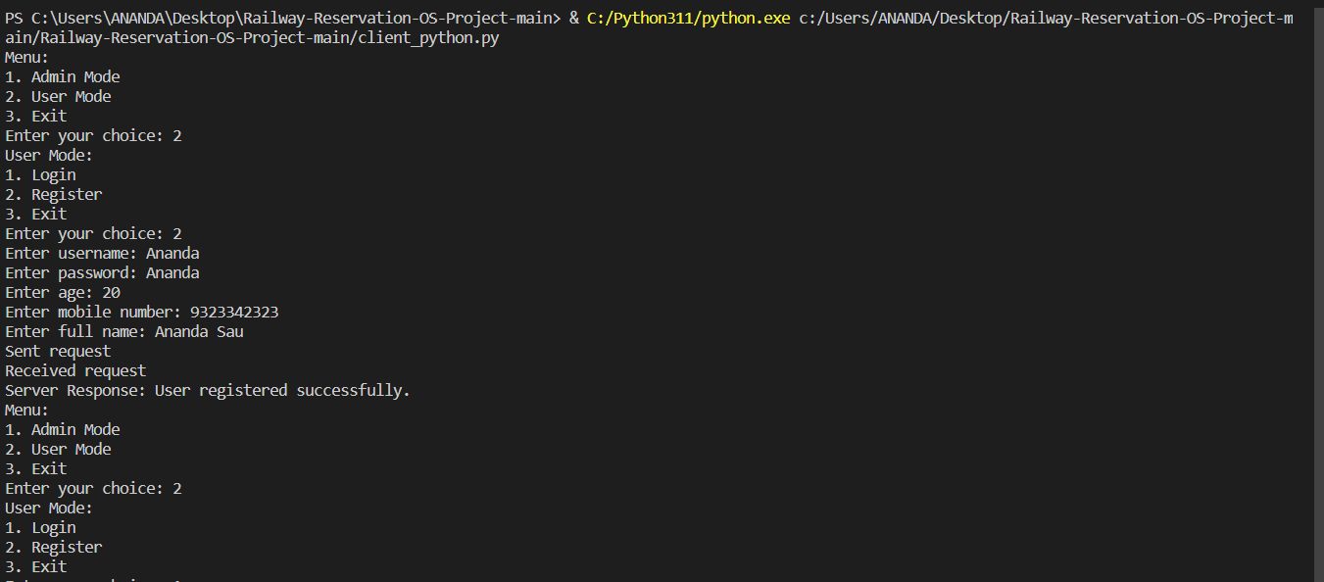
DESIGN PLAN OF USER INTERFACE
The user interface is simple and text based. The system can be used by typing required choices into the terminal. However, there is future scope to create a graphical user interface using HTML and CSS. A simple example of a user registering and logging in is shown below:

Slide 6
SERVER AND CLINET DESIGN
Our system is divided into two parts server side and client side each containing their required functions . Description of the classes are provided in the following slides.
SERVER/ADMIN
Funtionalities :
Client
Train
Reservation
Ticket
CLIENT/USER
Sends request to server
CLIENT/USER

Slide 7
Server Side :
✷ User Management
User Registration :
Function Parameters :Username, Mobile No. Password, Age , Full Name
User Login :
Function Parameters :Username, Password
Authenticate User :
Function Parameters :Username, Password
Display Profile :
Function Parameters :Username
Update Profile :
Function Parameters :Username , Age , Mobile Number
***Handling multiple users at a time can be done using the OS feature multithreading***

Slide 8
Server Side :
✷ Admin Management
Register New Train :
Parameters : Train No., Coach List, Seat Matrix, Stations, Schedule
DeleteRegistered Train :
Parameters : Train No.

Slide 9
Server Side :
✷ Train Management
1 . Book Tickets :
parameters : Username , Train Number .
2 . Seat Matrix :
parameters : Train Number .
3. Display User Ticket :
parameter : Username
4. Cancle Ticket :
parameters : Username , Ticket Number .

Slide 10
Client Side :
1)User
Login,Register, Search Trains, Book Tickets, Update Profile, Delete Profile, Cancel Reservations
2) Tickets
Reserve, Cancel, Check Available Ticket , Display Ticket
3)Once a ticket is booked the user receives a file with unique ticket reservation ID on it.
To access any function the user needs to send a request to the server through the use of sockets and get requests.

Slide 11
Client/ User
Server/Admin
Client/ User
Client/ User
Server Configuration:
✷ User Management:
Create, Authenticate, Delete, Update
✷ Train Management:
Add, Remove, Display
✷ Reservation Management:
Book, Cancel, Delete, Maintain seat matrix
Client Configuration:
✷ Account Management:
Register, Login, Update, Delete
✷ Ticket Management:
Reserve, Cancel, Check Schedule, Check ticket status, Check allotted seat

Slide 12
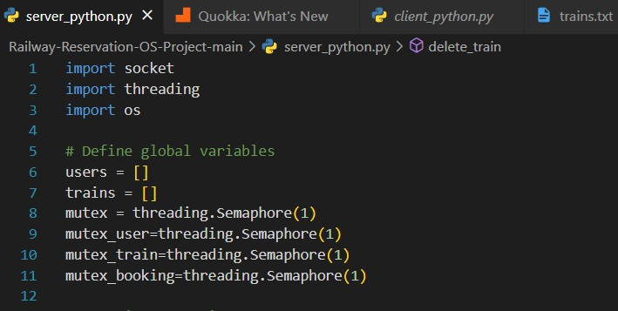
USE OF MULTITHREADING
Concurrent User Registration:
Utilize separate threads for each user registration request.
Enables the system to process multiple registrations simultaneously.
Enhances responsiveness and user experience.
Parallel Train Registration:
Employ multithreading for concurrent train registration tasks.
Each train registration operates independently in its thread.
Improves efficiency by allowing the system to handle multiple train additions concurrently.
Efficient Train Booking:
Implement threads for simultaneous train booking requests.
Users can book tickets concurrently without waiting for others.
Enhances the overall responsiveness of the train booking system.
Ensure proper synchronization mechanisms to prevent data conflicts and maintain integrity in this multithreaded environment.

Slide 13
USE OF SOCKET
Multi-Device User Interaction:
Utilize sockets to handle simultaneous interactions from multiple devices, allowing users to perform tasks like booking tickets or checking train details concurrently.
User Interaction From Different Terminal :
For socket testing we can use it first from different terminal in a same pc also
Scalability:
Scale the system easily to accommodate a growing number of clients on diverse devices by leveraging sockets for efficient communication.

Slide 14
PROJECT FLOWCHART
PROJECT TIMELINE:
Creation of server side code with required functions
Creation of client side code with required functions
Testing in same machine
Integration of the concept of transfer protocols, sockets, get requests to run client code in multiple machines
Integration of the concept of multithreading in server code to handle multiple requests from client simultaneously.

Slide 15
INDIVIDUAL ROLES
21CS8120 - Presentation, User
21CS8122 - Reservation Management
21CS8123 - User
21CS8124 - Reservation Policy
21CS8125 - User
21CS8126 - Reservation Policy
21CS8127 - Train Management
21CS8128 - Socket Implementation
21CS8129 – Presentation, Reservation Management

Slide 16
THANK YOU

